Slide 1



Expanded Sentences

Slide 2
Answer these questions to frame long sentences
Who is doing it?
What is doing?
How is doing?
When is doing?
Where is doing?
Why is doing?

Slide 3



A rabbit digs a hole.
Who?
What?
How?
Where?
When?
Why?

Slide 4
A rabbit digs a hole.
Who?
A rabbit
What?
digs
How?
quickly/ slowly/ enthusiastically
Where?
in the park
When?
in autumn
Why?
to stay warm

Slide 5
Can you find out the answers to the questions?
The furry pink rabbit digs a deep burrow quickly in autumn in the park to hide his food and stay warm in winter.
words count: 24

Slide 6
The furry pink rabbit digs a deep burrow quickly in autumn in the park to hide his food and stay warm in winter.
who
what
how
when
where
why
words count: 24

Slide 7
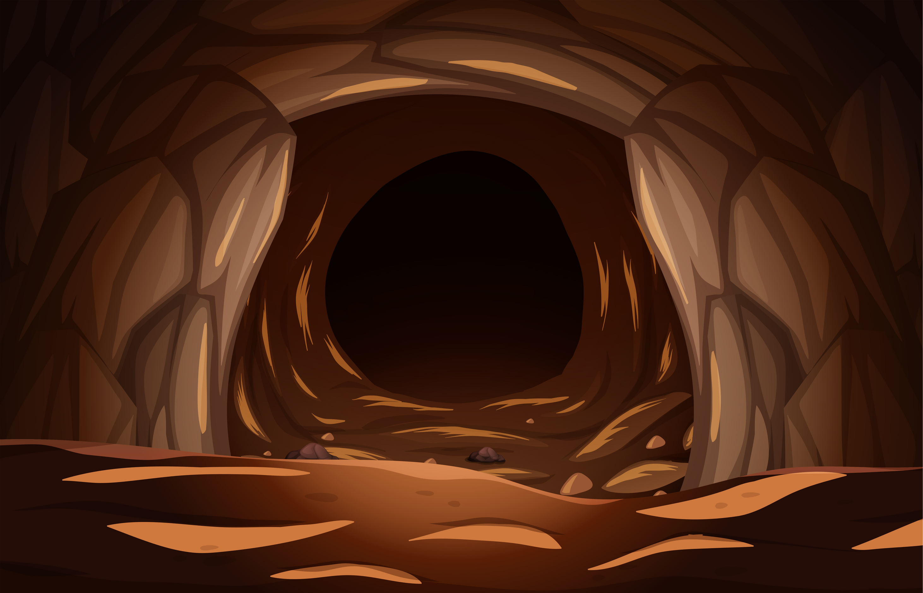

Who?
What?
How?
Where?
When?
Why?
The bear was snoring.

Slide 8
Who?
A bear
What?
snoring
How?
loudly
Where?
in a cave
When?
in the afternoon
Why?
He is tired
The bear was snoring.

Slide 9
Can you find out the answers to the questions?
The ferocious bear was snoring loudly in a deep, gloomy cave in the afternoon after his lunch because he was too tired.

Slide 10
The ferocious bear was snoring loudly in a deep, gloomy cave in the afternoon after his lunch because he was too tired.
who
what
how
where
when
why

Slide 11
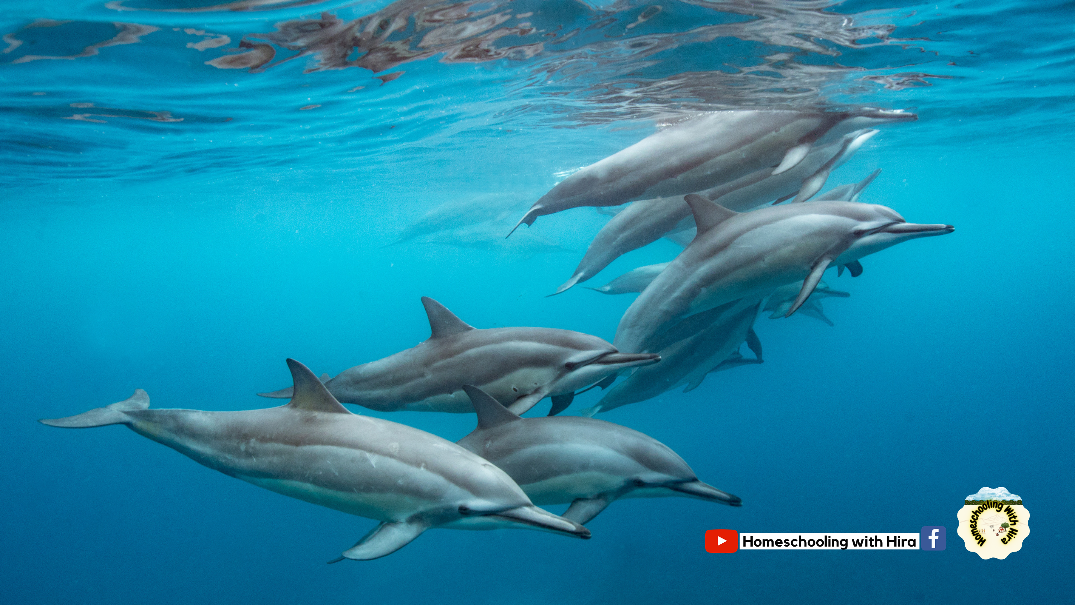
Who?
What?
How?
Where?
When?
Why?

Slide 12
Who?
A school of dolphins
What?
roaming through water
How?
delightfully/whimsically
Where?
in the deep ocean
When?
early morning
Why?
in search of food

Slide 13
Who?
A school of dolphins
A school of dolphins is roaming through the water whimsically in the deep blue ocean early in the morning in search of food.
What?
roaming through water
How?
delightfully/whimsically
Where?
in the deep ocean
When?
early morning
Why?
in search of food

Slide 14




To get the complete resource pack, check out our shop!
Homeschooling with Hira

